Slide 1
Single Image Super Resolution (SISR)
Achint Chaudhary
D Awadhesh Tanwar

Slide 2
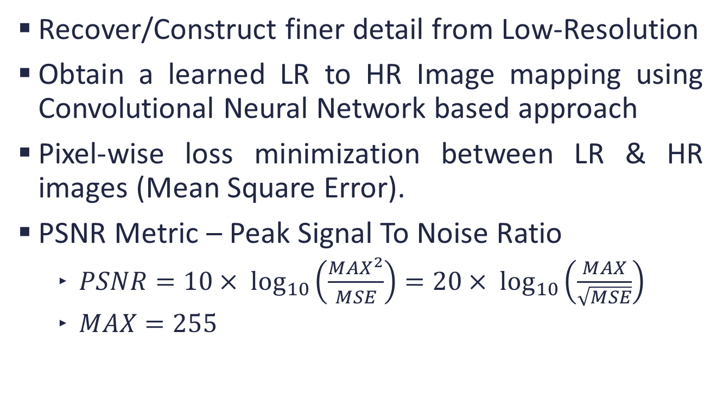
SISR
Recover/Construct finer detail from Low-Resolution
Obtain a learned LR to HR Image mapping using Convolutional Neural Network based approach
Pixel-wise loss minimization between LR & HR images (Mean Square Error).
PSNR Metric – Peak Signal To Noise Ratio
$PSNR=10× \log_{10}\left(\frac{{MAX}^{2}}{MSE}\right)=20× \log_{10}\left(\frac{MAX}{\sqrt{MSE}}\right)$
$MAX=255$
Notes:
Log to better caption MSE near zero

Slide 3
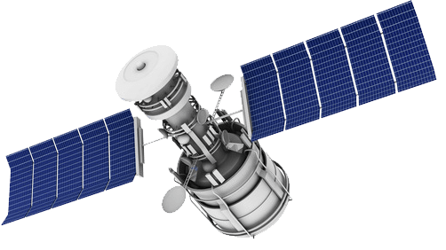
Applications of SISR
Satellite Imaging
Medical Imaging
Security Imaging
Note: No artificial texture generation can be tolerated in these applications

Slide 4
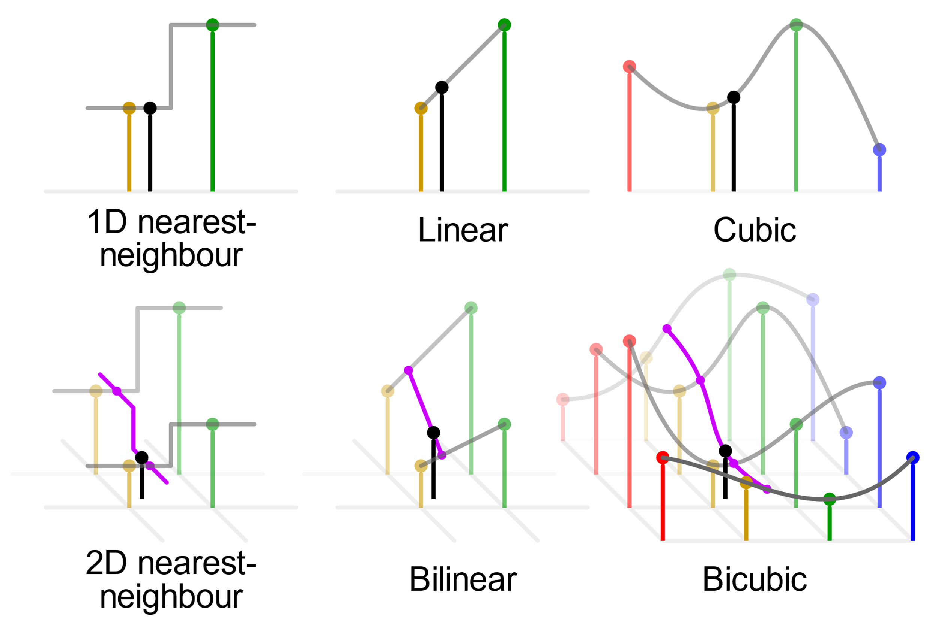
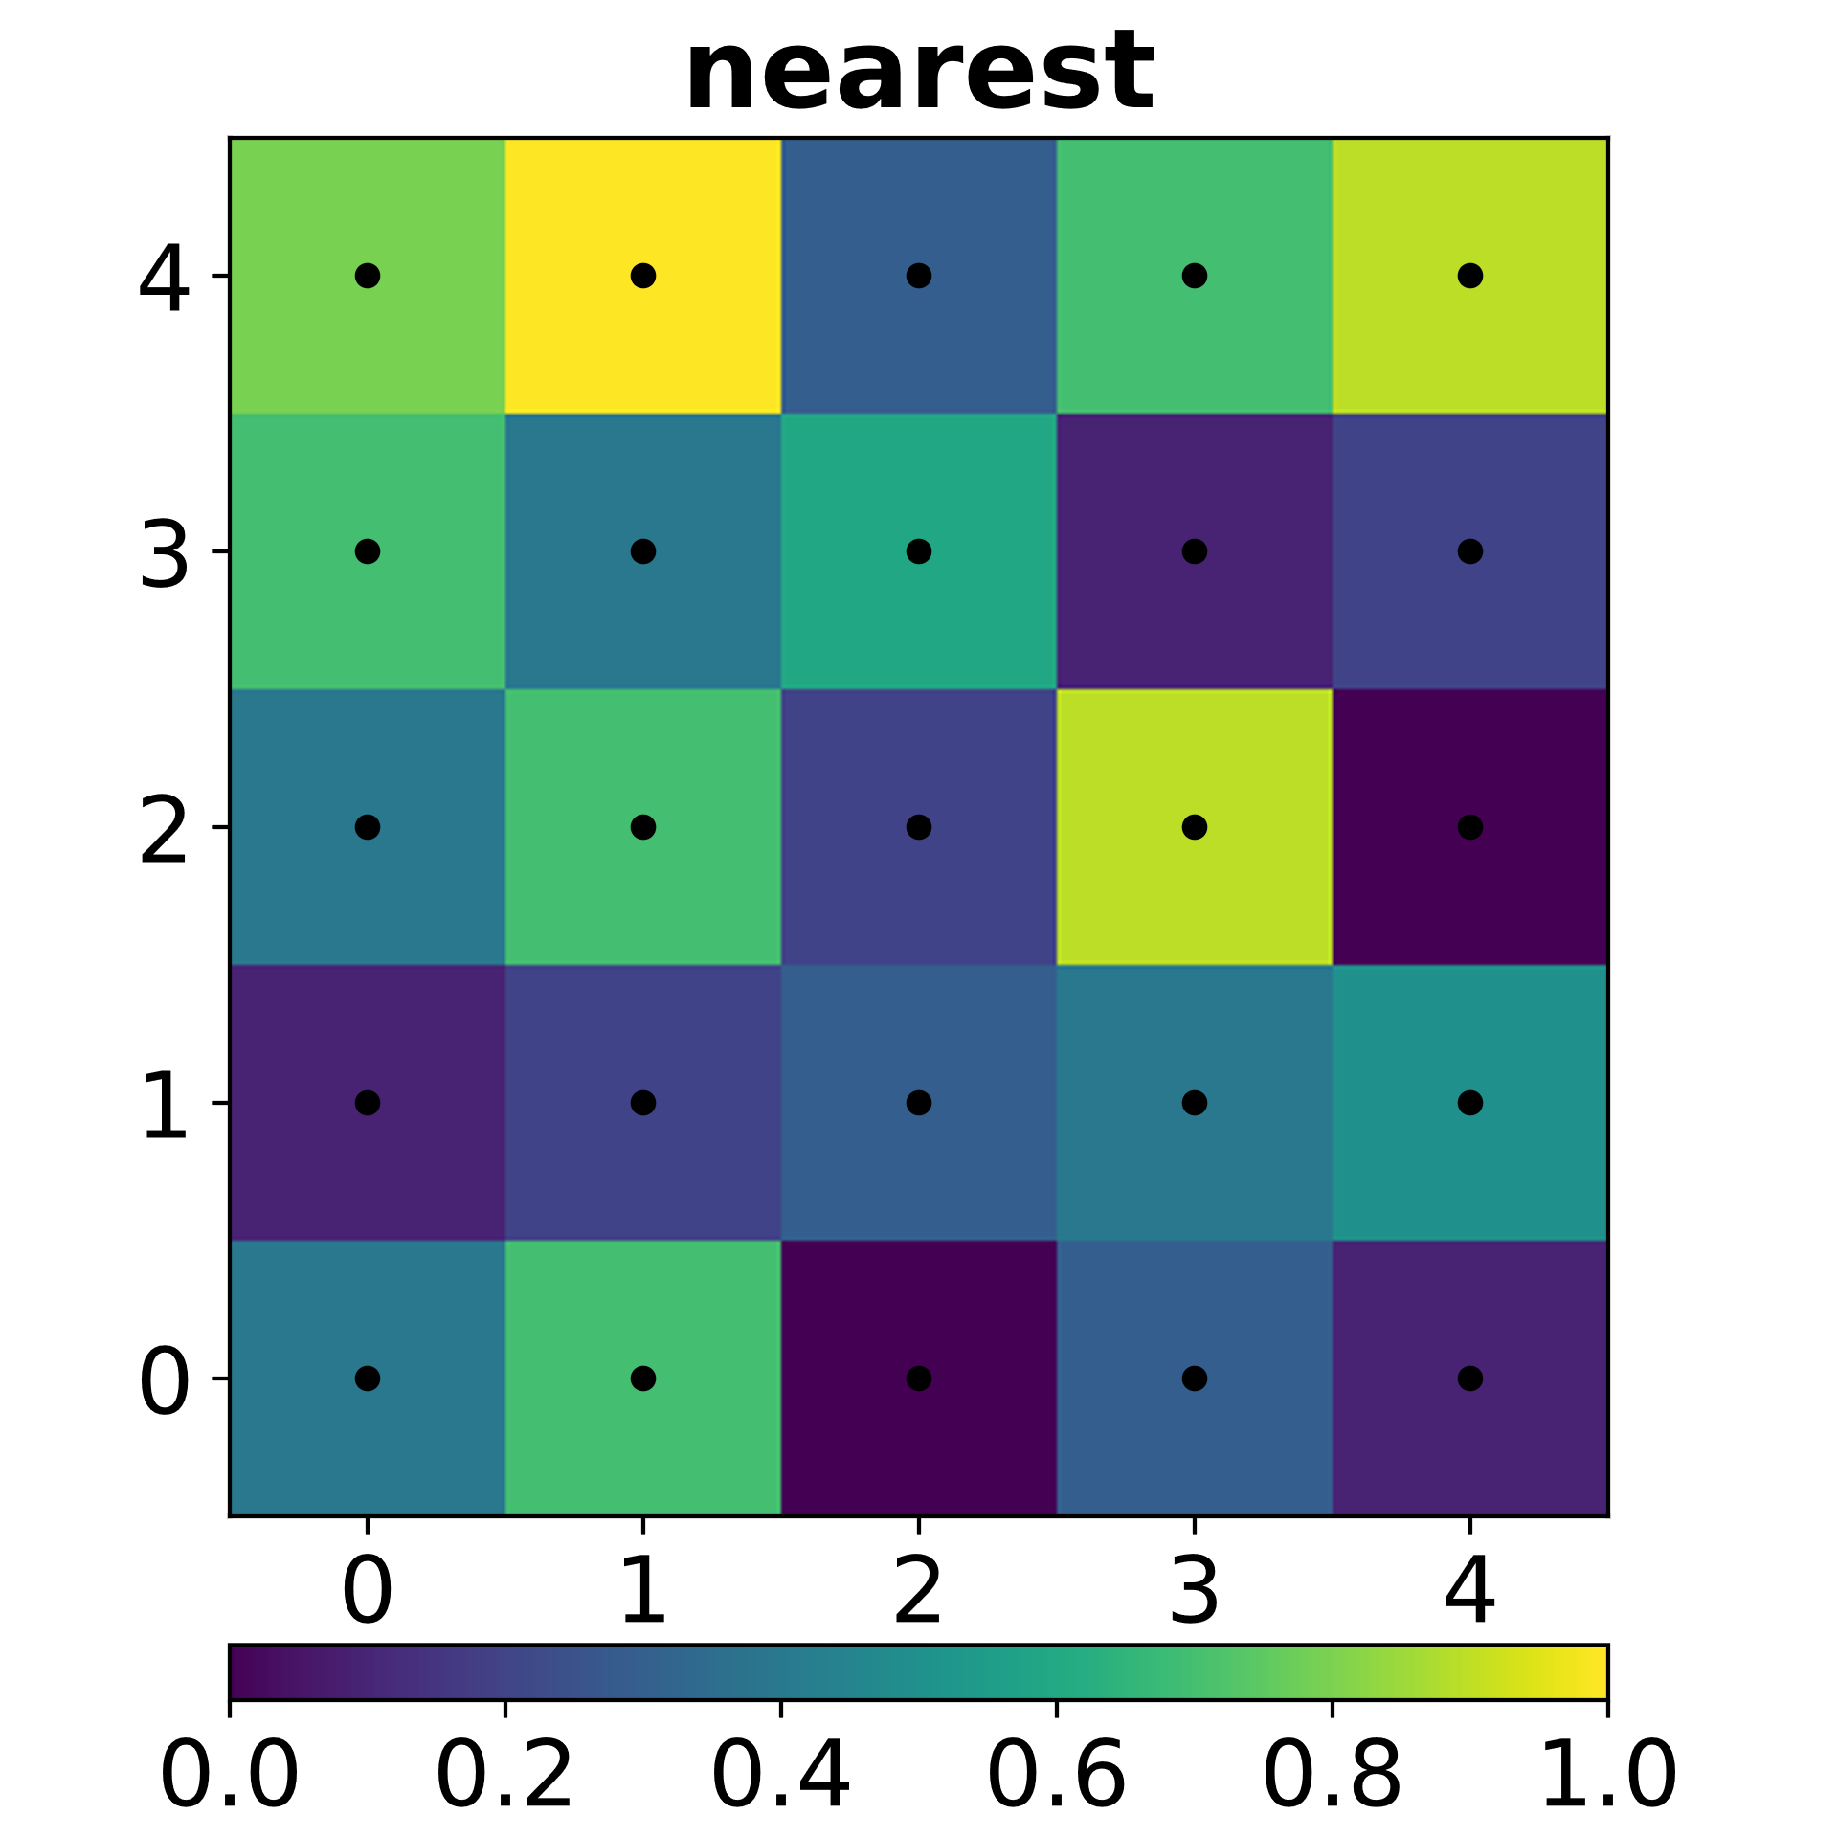
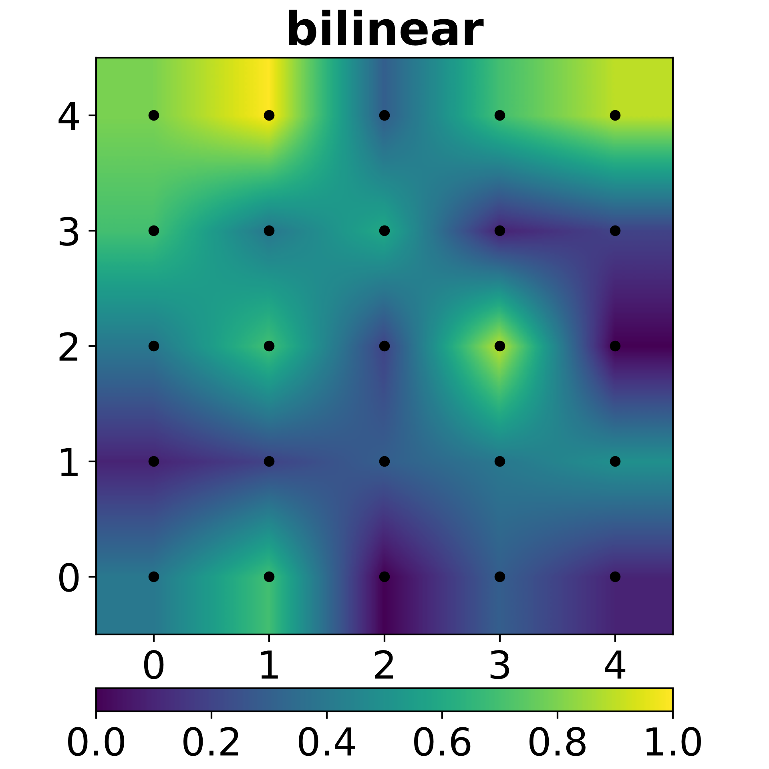
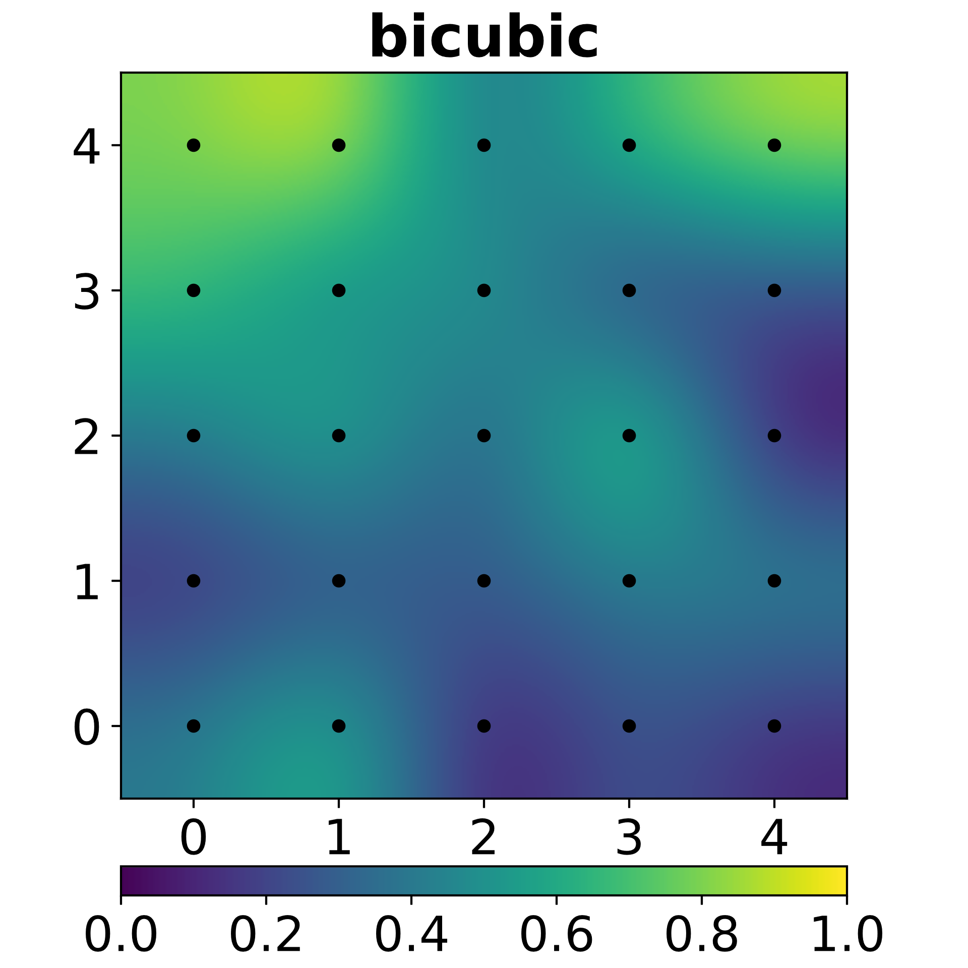
Classic Interpolation
Image courtesy : https://en.wikipedia.org/wiki/Bicubic_interpolation

Slide 5
Training Datasets
DIV2K: 800 images of 2K Resolution
Flickr2K: 2650 2K images
Challenge on Learned Image Compression (CLIC):
CLIC-professional: 585 images of 480p to 2K
CLIC-mobile: 1048 images of 320p to 2K

Slide 6
Testing Datasets
PIRM Perceptual Image Super-Resolution Challenge
BSDS100: 100 images
Set5 & Set14: common SISR evaluation datasets
Urban 100: FHD images of Urban scene
Manga 109: Images of Anime comic covers
Validation sets of DIV2K, CLIC

Slide 7
Data Preparation
Datasets are of High-Resolution images
Obtained Low Resolution via bicubic down-sampling
Scale Factor: 4
Patches
LR: 32x32
HR: 128x128
Images of different resolution and formats
Notes:
Put patches wala animation

Slide 8
Experimental Setup
Intel(R) Core(TM) i7-8700K CPU @ 3.70GHz
16 GB DDR4 2400MHz RAM
12 GB NVIDIA 1080Ti GPU

Slide 9
Model Selection (Exp 0.)
Type 1: Takes interpolated LR image as input
High resource intensive & difficult to converge
Type 2: Takes LR input, works on LR feature space, later find a learned up-sampling
Less resource intense & converges easily
SRResNet is best in terms of accuracy & resource usage
Notes:
Vdsr, drrn,oadnn
Srresnet,edsr

Slide 10
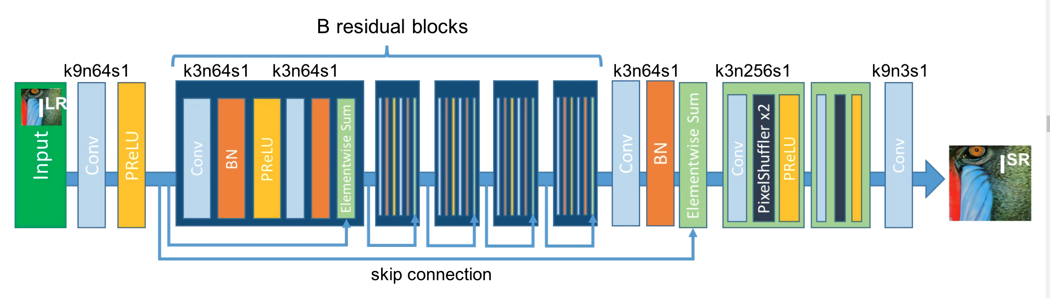
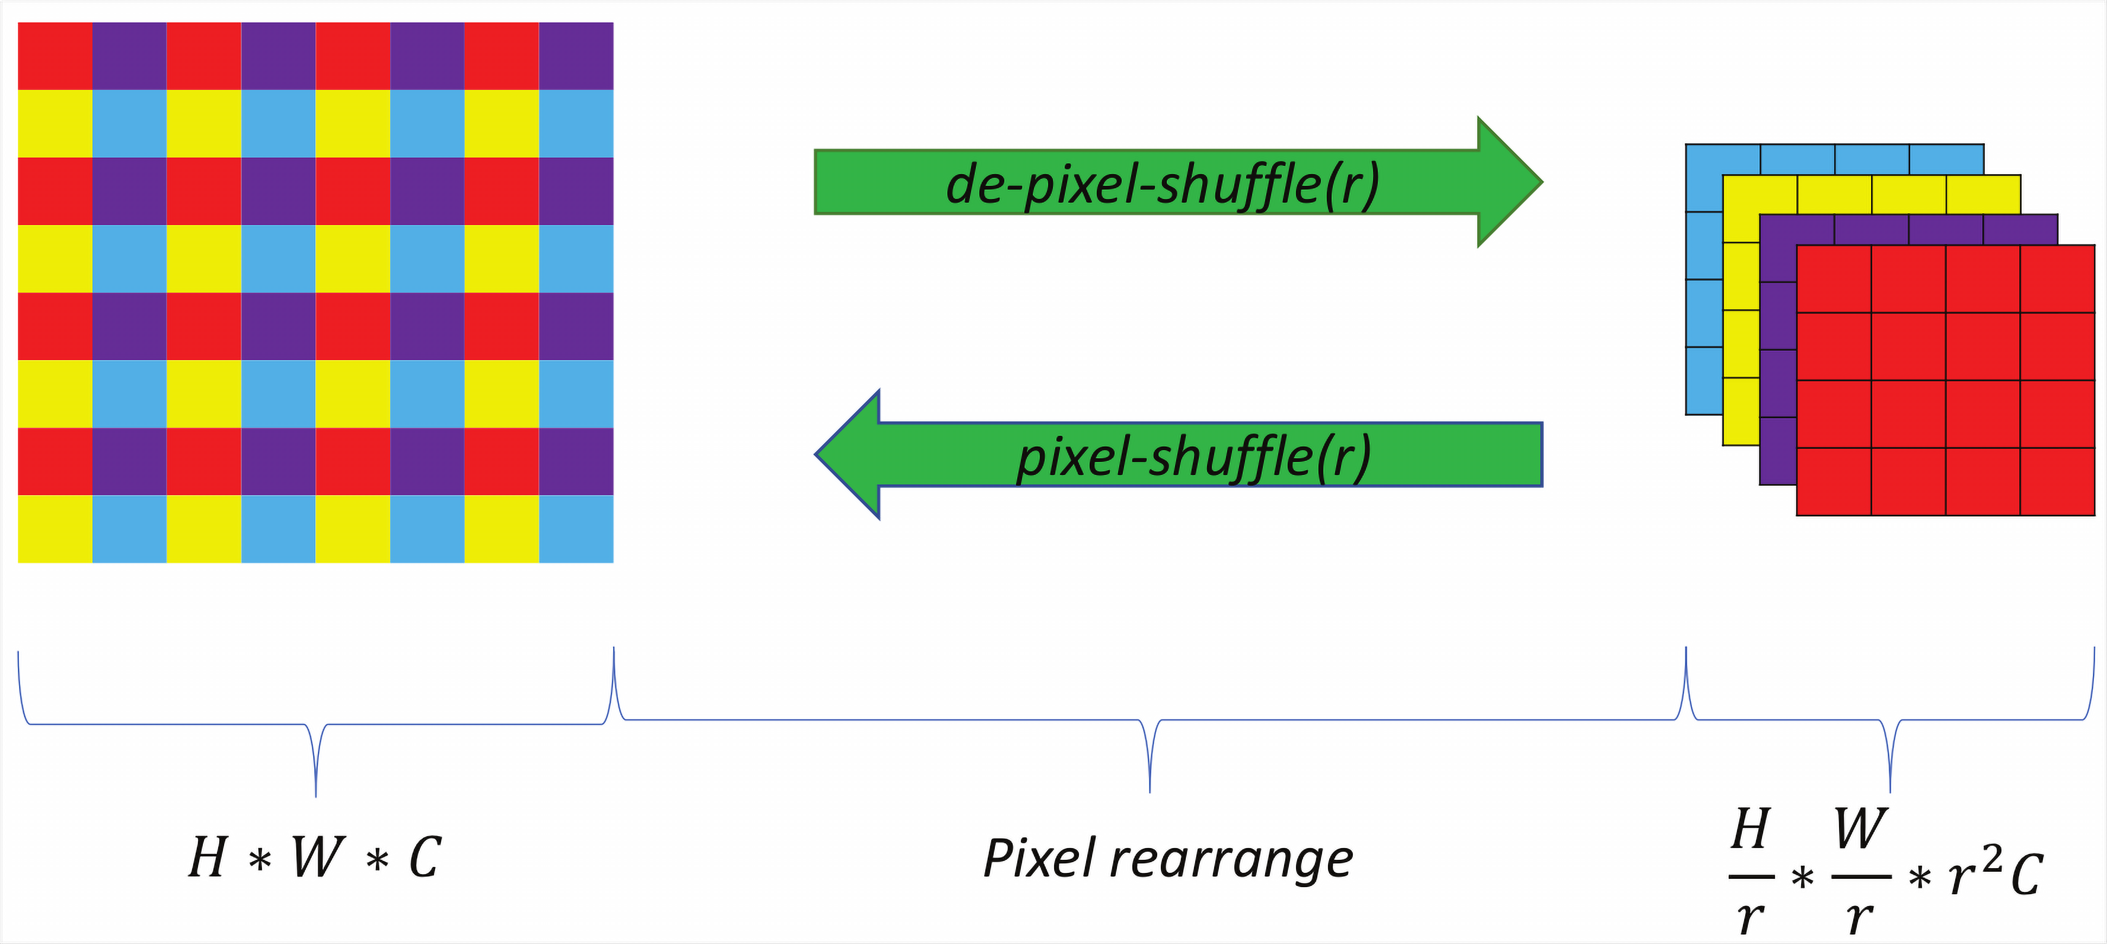
SRResNet Architecture
Notes:
B = 16

Slide 11
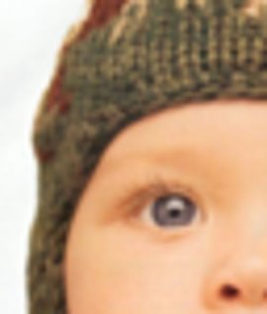
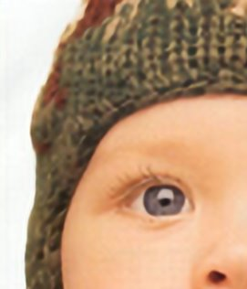
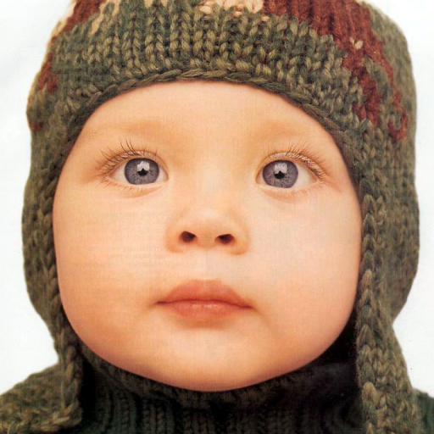
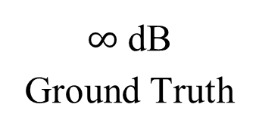
Output images & PSNR values
30.83 dB
LR (Bicubic)
32.50 dB
SRResNet
$∞$ dB
Ground Truth
PSNR Gain 1.67 dB

Slide 12
Mean PSNR Gain over Bicubic on separate SRResNet instances
Test/Valid Dataset | DIV2K | Flickr2K | CLIC-professional | CLIC-mobile | Min Diff
CLIC-mobile | 1.43 | 1.28 | 1.34 | 1.16 | 0.09
CLIC-professional | 1.64 | 0.88 | 1.49 | 1.20 | 0.15
DIV2K | 1.55 | 1.11 | 1.27 | 1.12 | 0.28
BSDS100 | 1.73 | 1.39 | 1.44 | 1.32 | 0.29
Manga109 | 4.01 | 3.75 | 3.39 | 3.03 | 0.26
PIRM | 1.40 | 1.27 | 1.25 | 1.08 | 0.13
PIRM | 1.37 | 1.24 | 1.19 | 1.02 | 0.13
Set5 | 1.79 | 1.65 | 1.57 | 1.38 | 0.14
Set14 | 2.77 | 2.33 | 2.45 | 1.98 | 0.32
Urban100 | 2.00 | 1.86 | 1.78 | 1.57 | 0.14
Notes:
Min Diff, is Minimum PSNR gain, by training on best & second best dataset

Slide 13
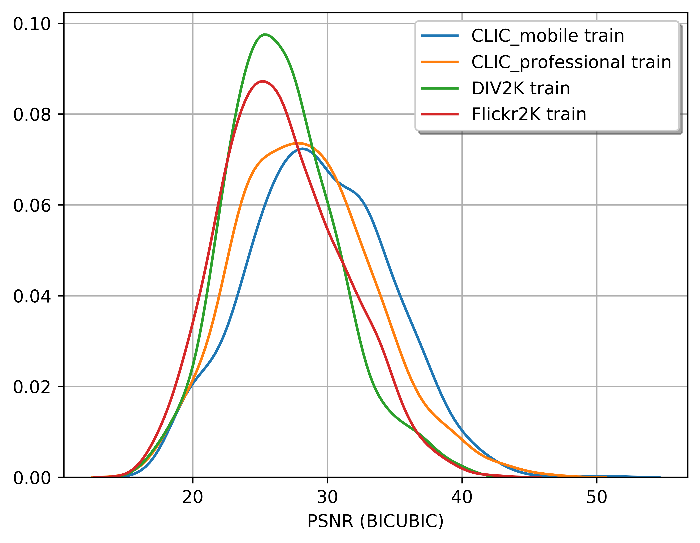
Data-Set Ranking (Exp 1.)
Why (& How) training on different dataset matter?
Fine details are difficult to recover from Bicubic
Notes:
Gaussian density estimation, of PSNR from bicubic of all training sets

Slide 14
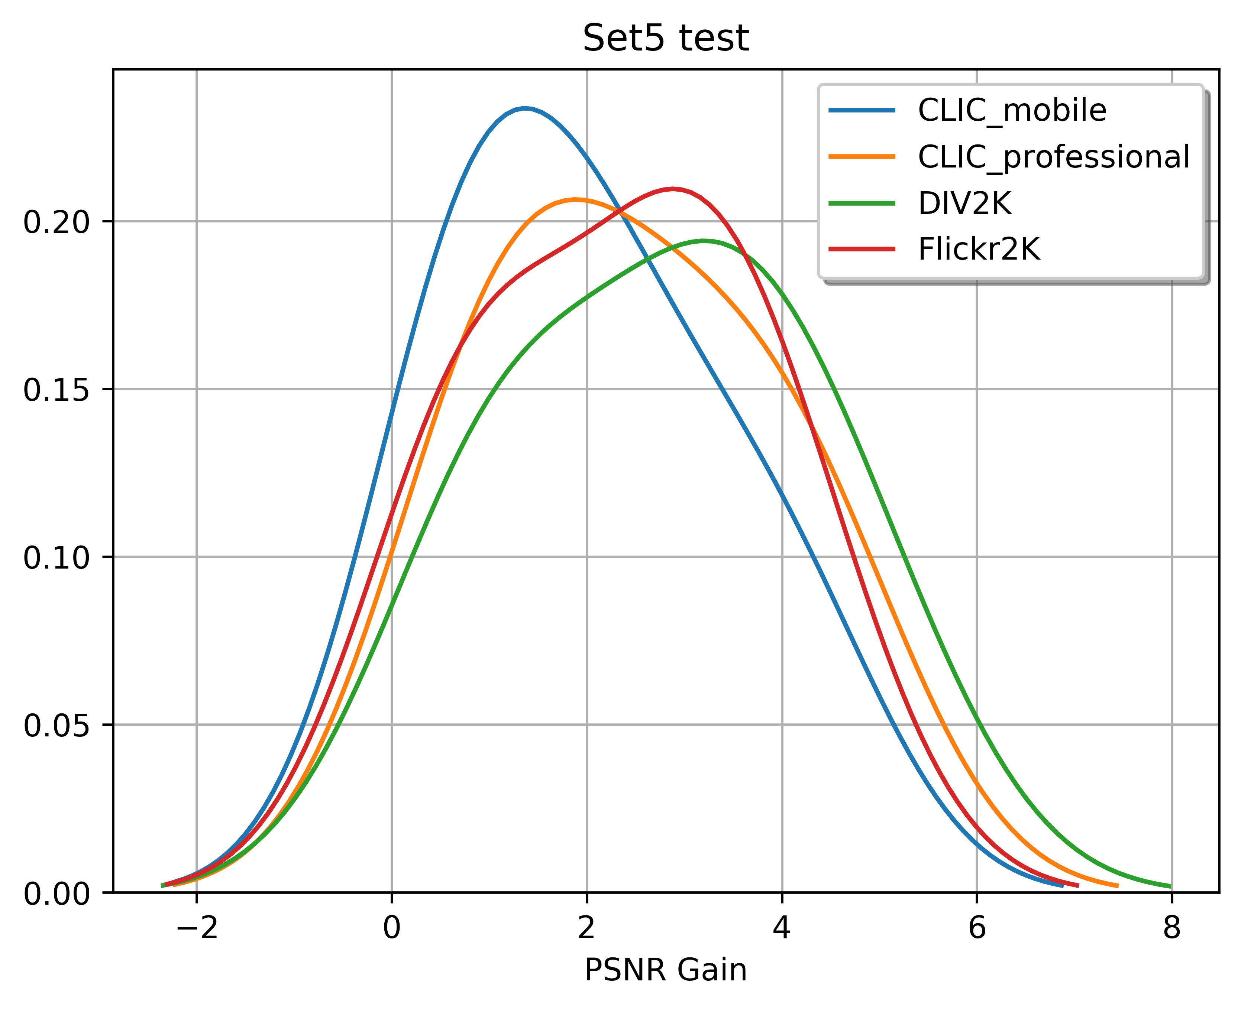
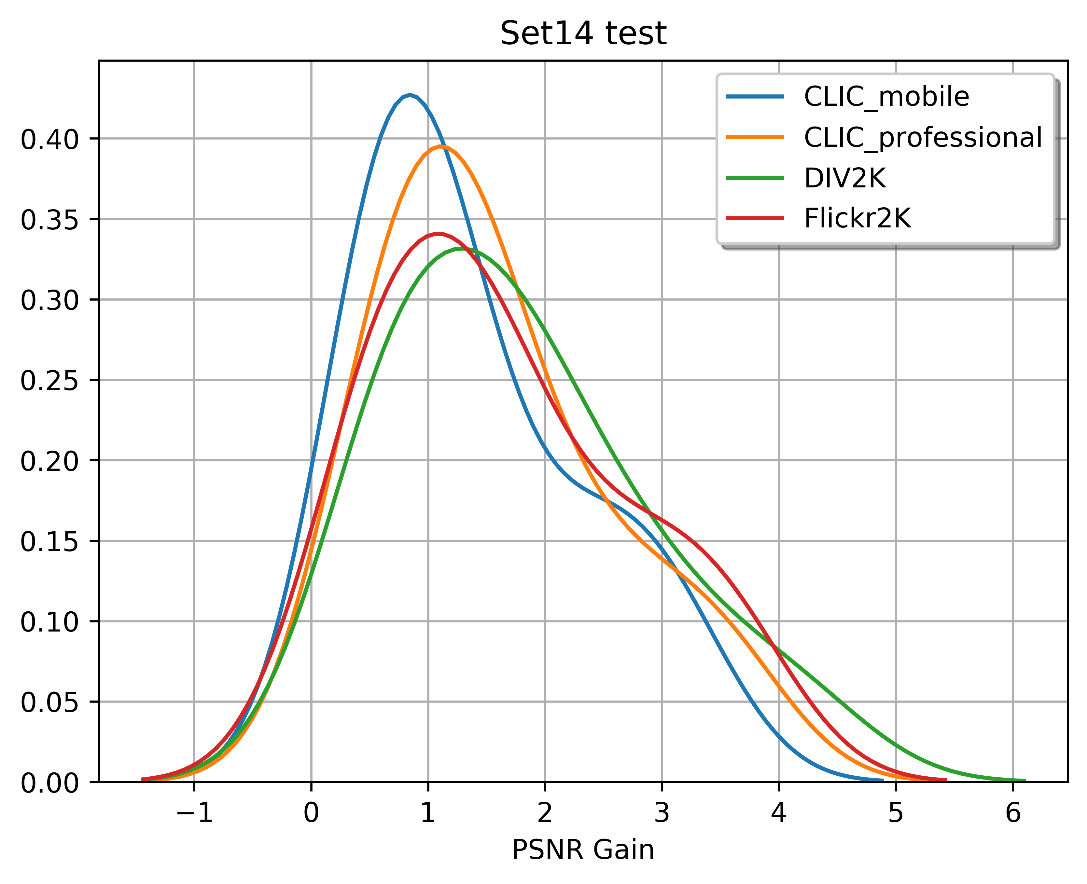
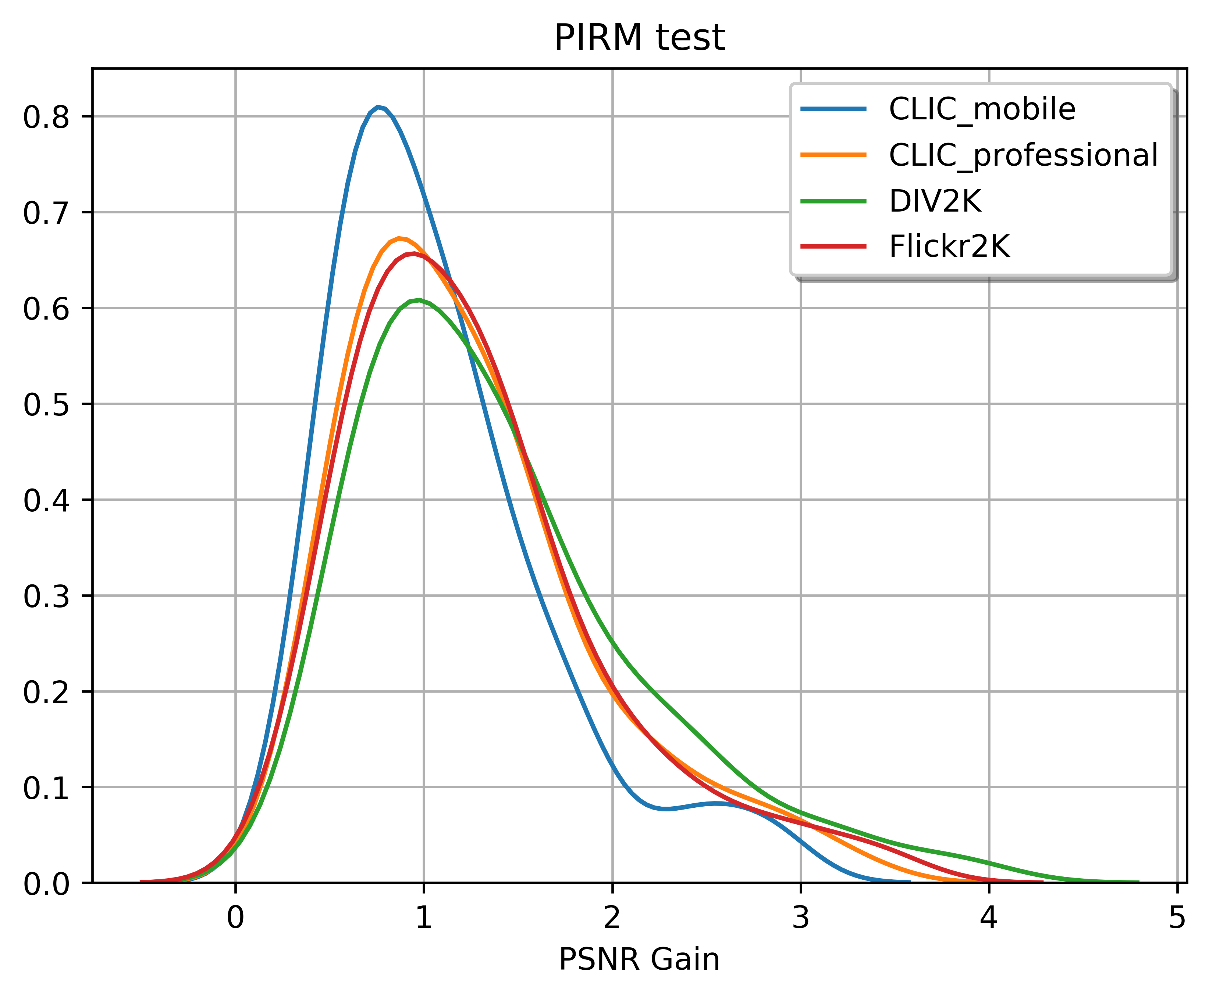
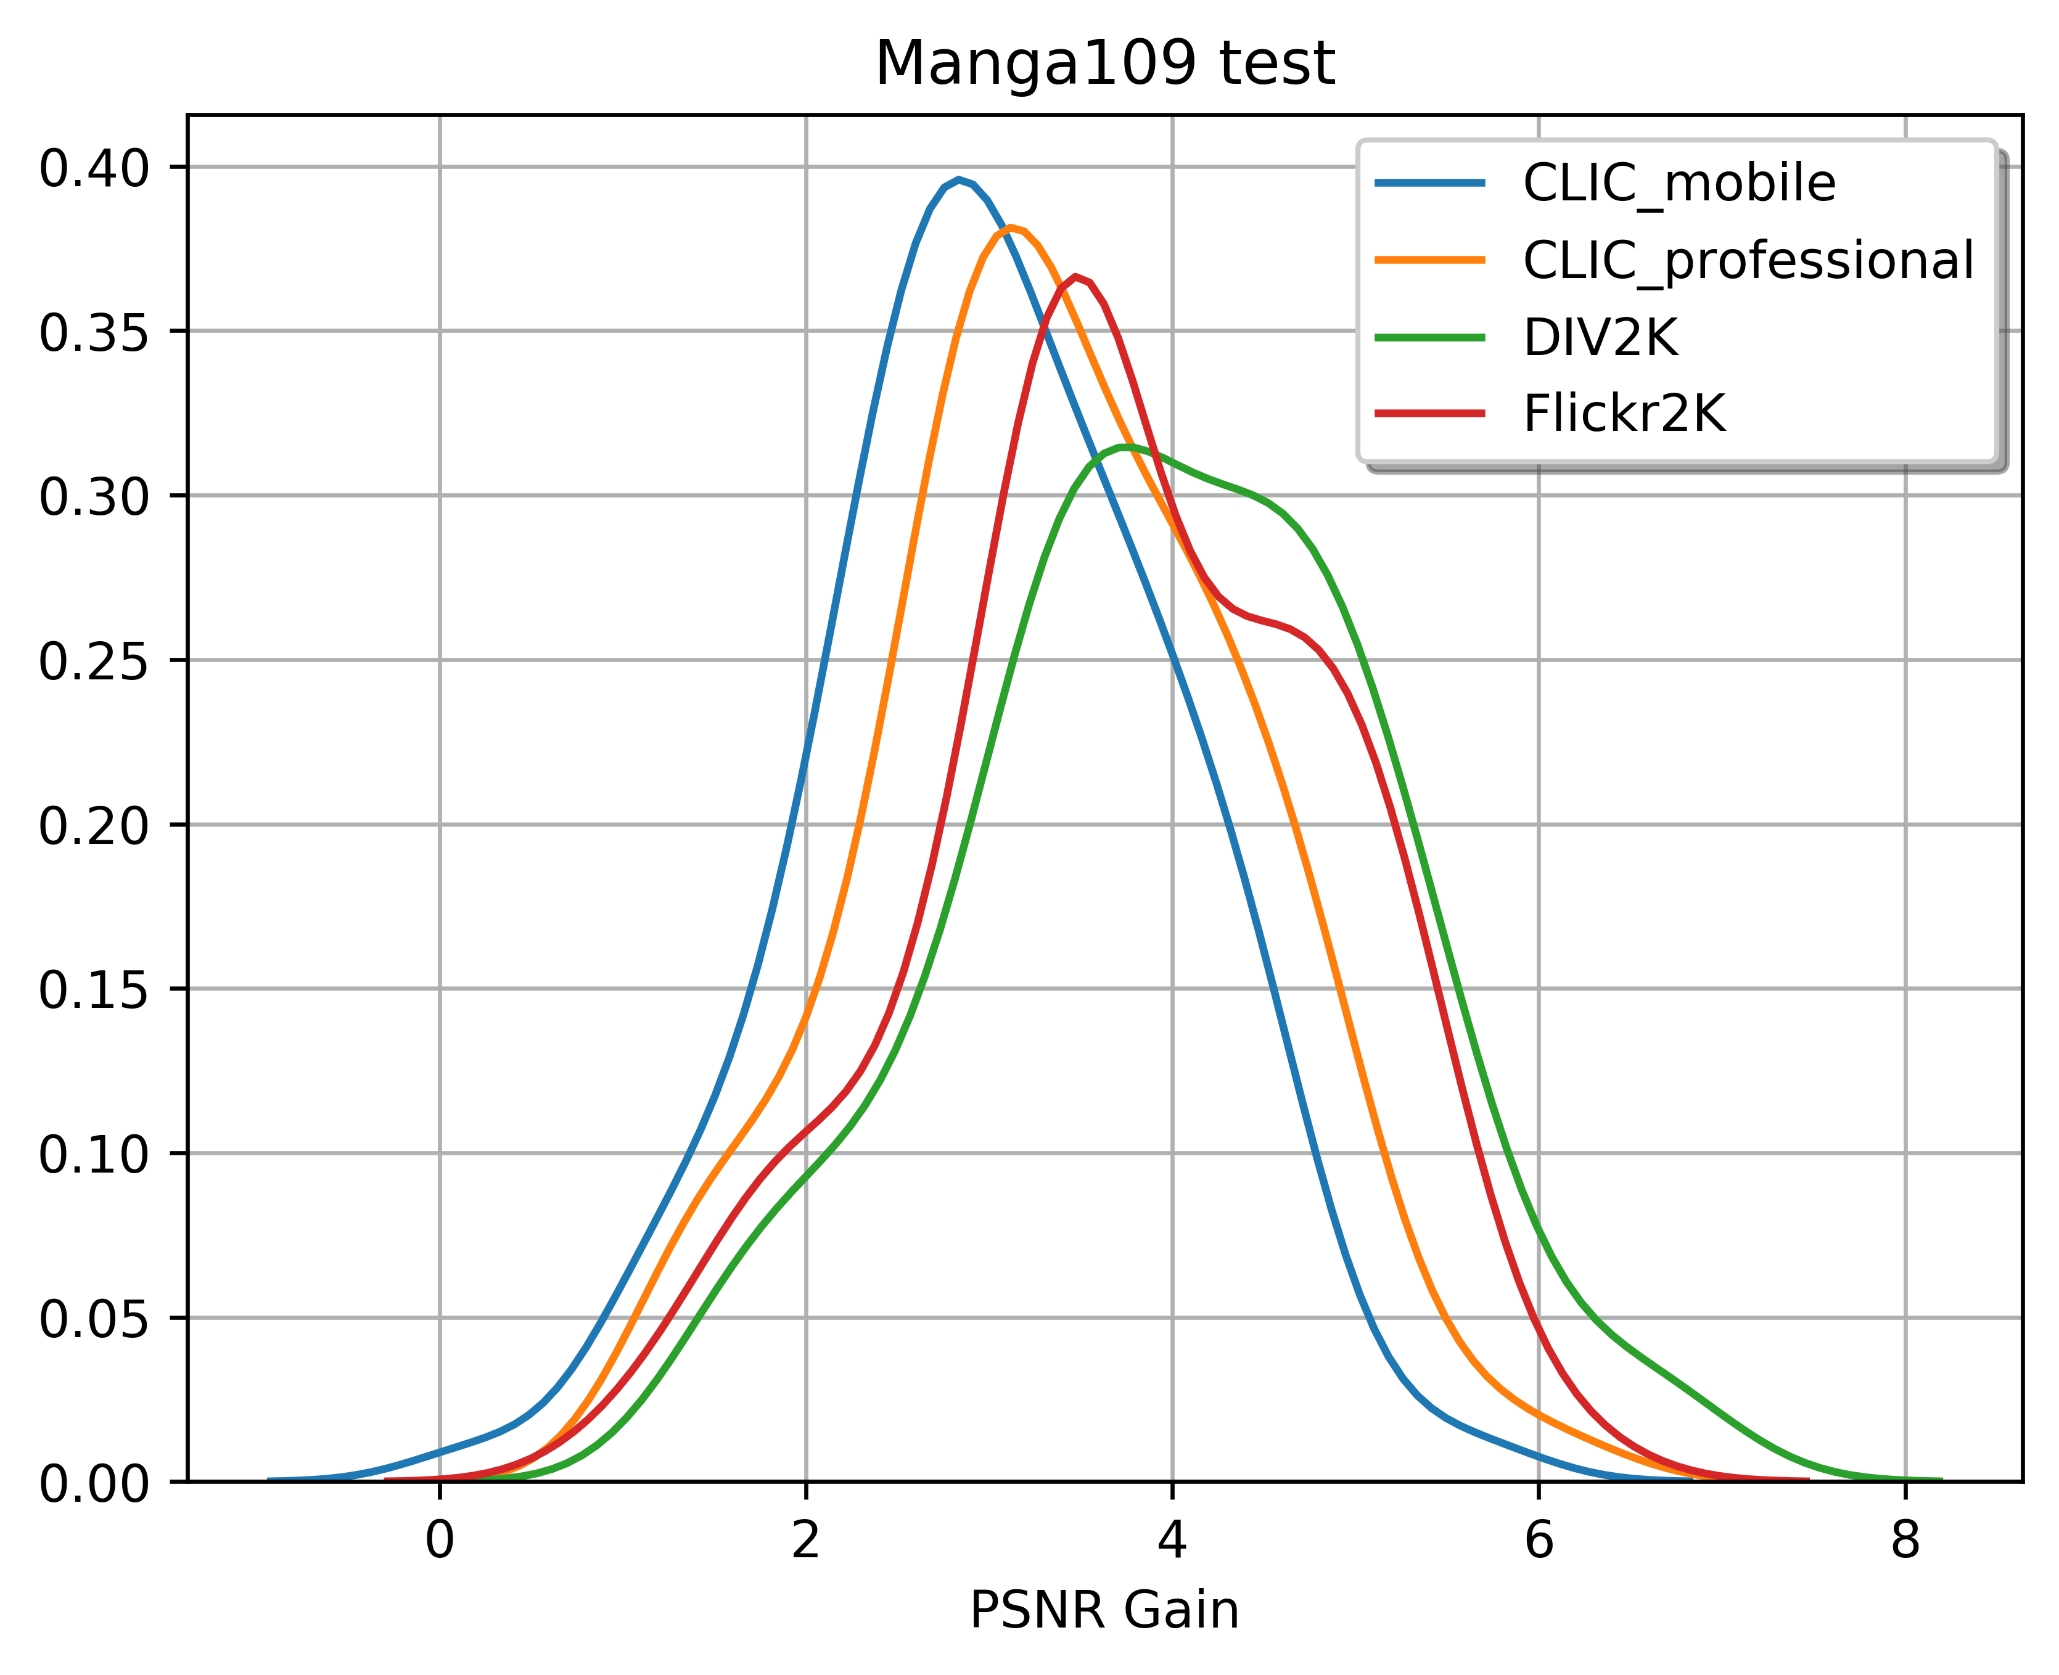
Data-Set Ranking (Exp 1.)
Notes:
Order on X-axis from previous slides are reversed as per our observation

Slide 15
Data Sampling (Exp 2.)
Batches from disk are taken uniformly for training
Observation from Exp 1., motivates us to use some specific sampling mechanism
Like Exp 1. does rank datasets, some Scoring can be assigned to individual images/patches
Notes:
Disk batching is commonly used in practice

Slide 16
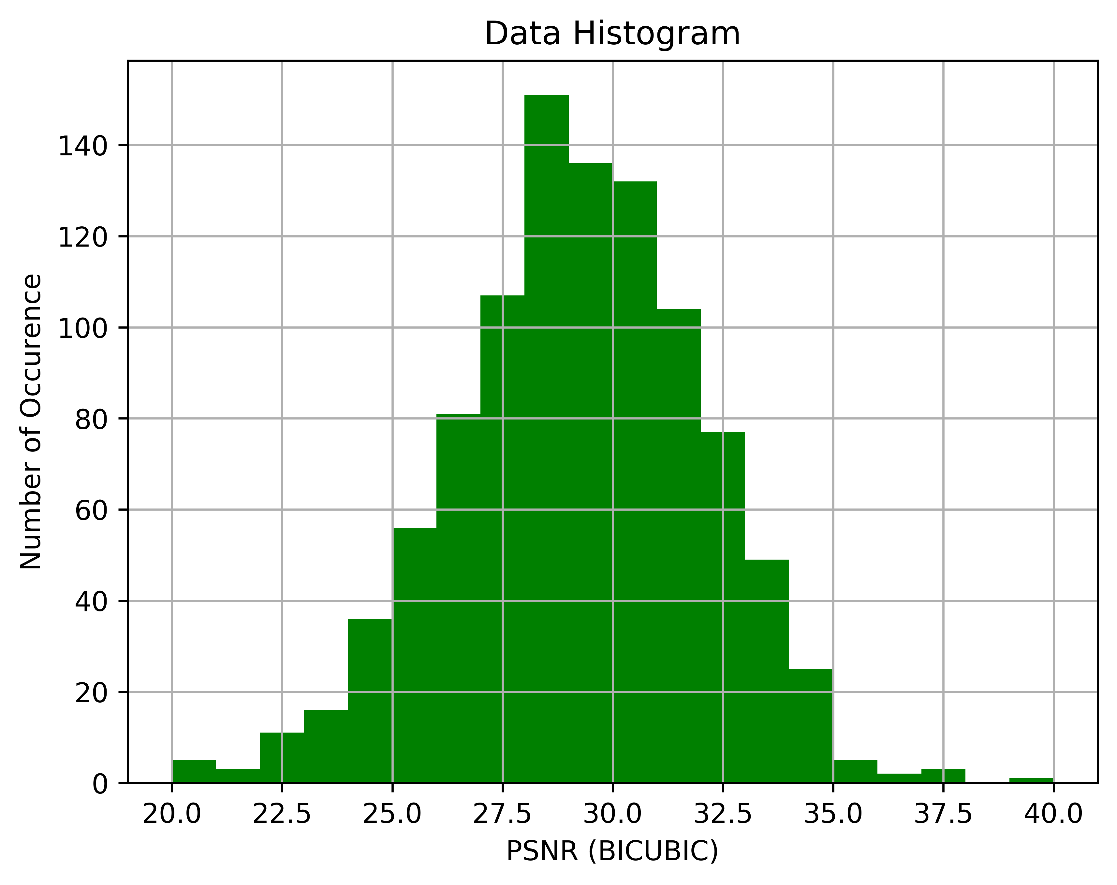
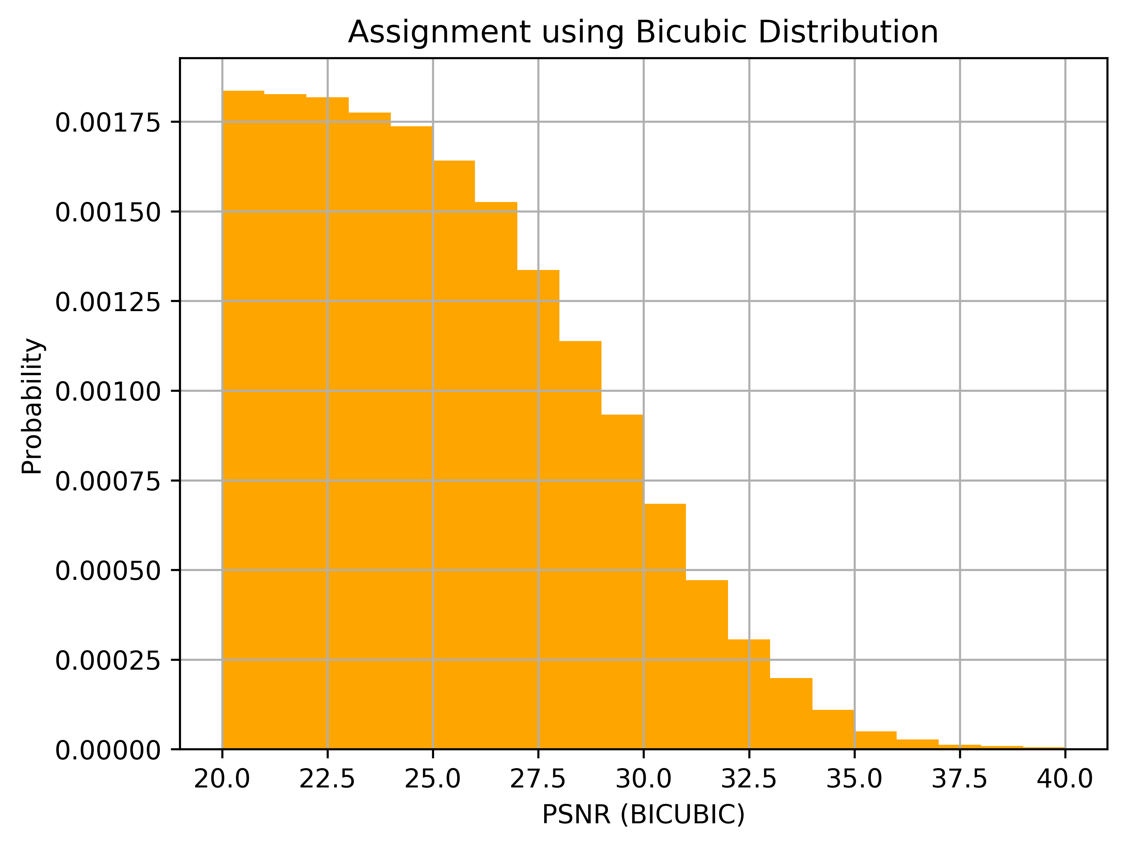
Sampling Algorithm
Observed data distribution of patches is Gaussian
Less detailed patches are easier to reconstruct using bicubic
Results in relatively high PSNR value
and vice-versa
Thus, low PSNR patches should be preferred over high PSNR ones
Notes:
Normalised reverse cumulatve dist of patches

Slide 17
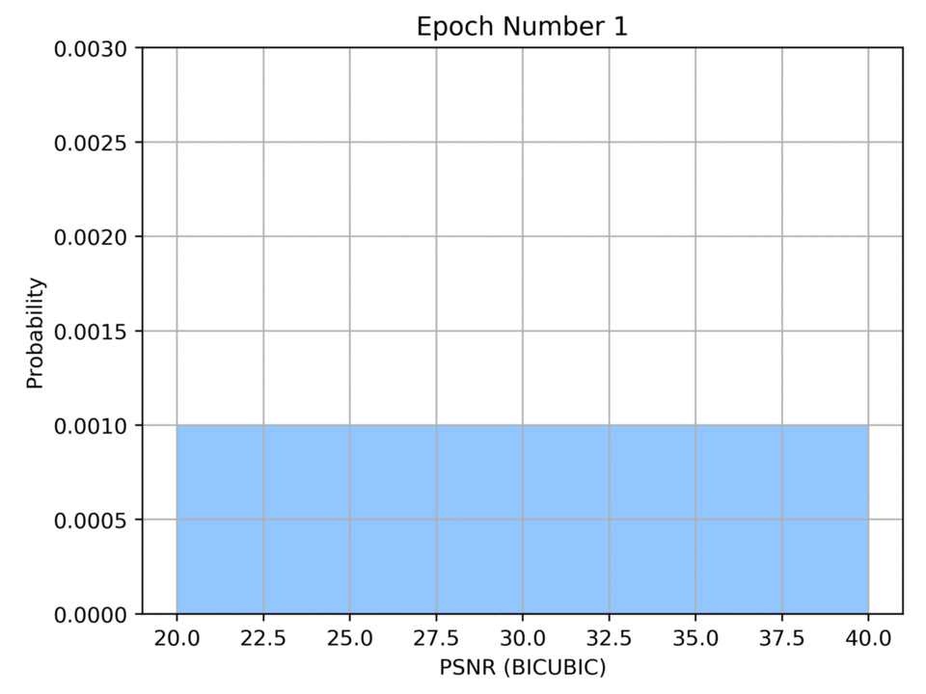
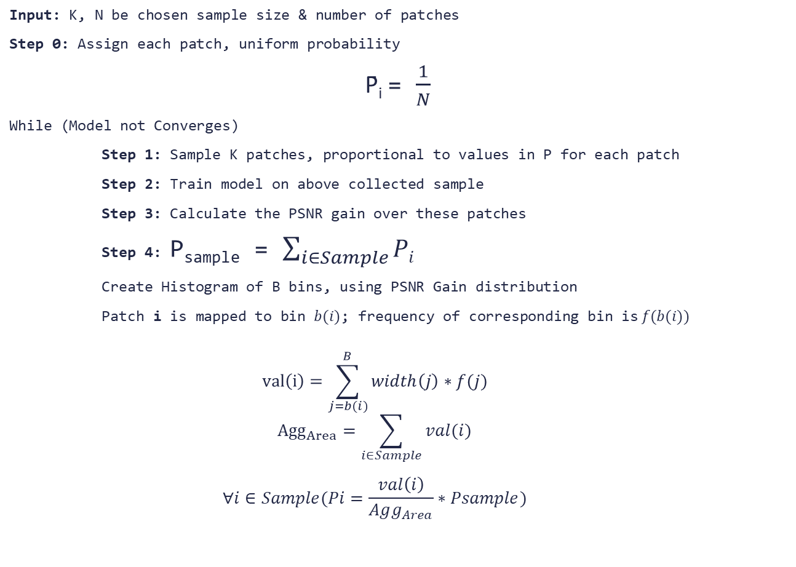
Algorithm Pseudocode
Input: K, N be chosen sample size & number of patches
Step 0: Assign each patch, uniform probability
P̄_{i} = $\frac{1}{N}$
While (Model not Converges)
Step 1: Sample K patches, proportional to values in P for each patch
Step 2: Train model on above collected sample
Step 3: Calculate the PSNR gain over these patches
Step 4: P_{sample} = $\sum_{i∈Sample}{Pi}$
Create Histogram of B bins, using PSNR Gain distribution
Patch i is mapped to bin $b(i)$; frequency of corresponding bin is$f(b(i))$
$$val\left(i\right)=\sum_{j=b(i)}^{B}{width\left(j\right)∗f(j)}$$
$${Agg}_{Area}=\sum_{i∈Sample}{val(i)}$$
$$∀i∈Sample(Pi=\frac{val\left(i\right)}{Agg_{Area}}∗Psample)$$
Notes:
B = 20

Slide 18
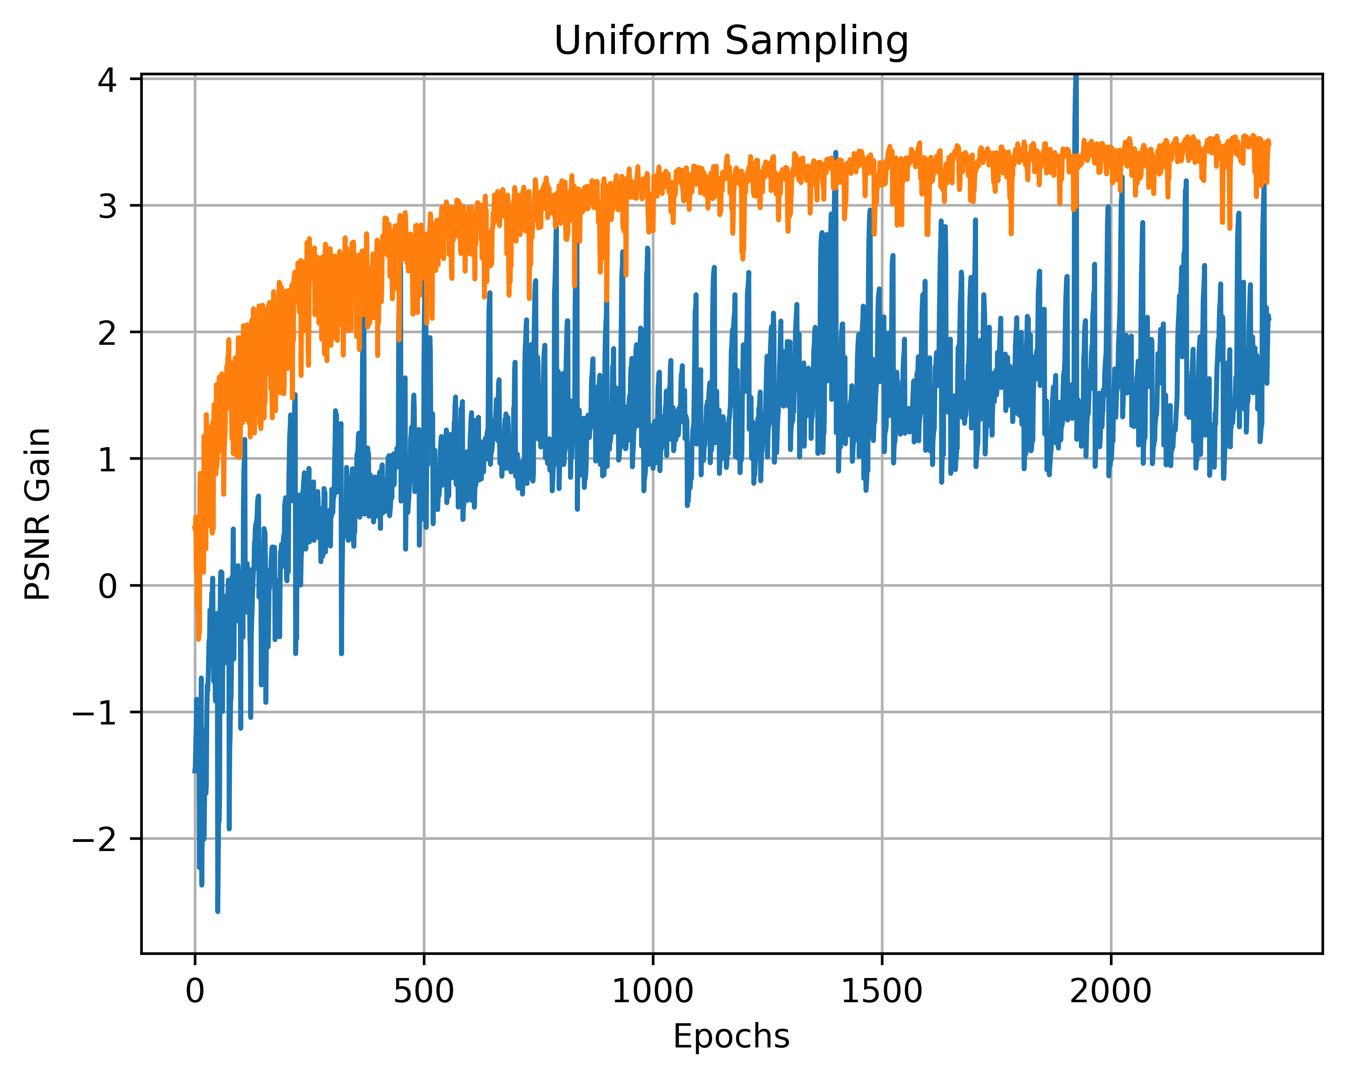
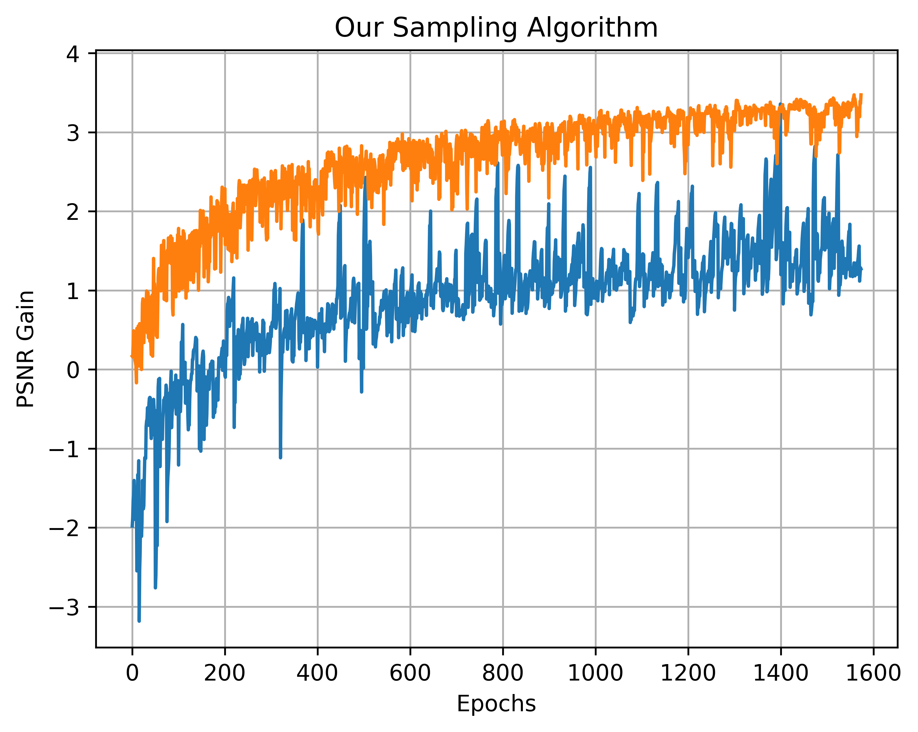
Convergence Performance
Our sampling algorithm results in faster convergence
Using Patch level approach instead of full image allows
Fine grained control
No need of extra inference from SRResNet

Slide 19
Core Findings
Dataset-Ranking (Inter-Dataset) approach helps obtaining better performance
Data-Sampling (Intra-Dataset) approach further enables faster convergence
Combining all datasets will saturate in practice
Techniques like our algorithm can be used to train vision models on extremely large datasets

Slide 20
Conclusion
Analysed & Benchmarked various SISR models from the literature
Characterize training datasets for best performance
Proposed & empirically verified a data sampling algorithm for faster convergence of the model

Slide 21
Future Work
Similar Dataset Ranking & Data Sampling approach can be used for other low-level vision applications like Compression Artefacts Removal, De-noising.,
Reduction in training time can be further obtained by other probability initialization unlike uniform

Slide 22
References
CLIC Challenge - https://www.compression.cc/challenge/
Agustsson, E., & Timofte, R. (2017). NTIRE 2017 challenge on single image super-resolution: Dataset and study. In Proceedings of the IEEE Conference on Computer Vision and Pattern Recognition Workshops (pp. 126-135).
Matsui, Yusuke, et al. "Sketch-based manga retrieval using manga109 dataset." Multimedia Tools and Applications 76.20 (2017): 21811-21838.
Lai, Wei-Sheng, et al. "Deep laplacian pyramid networks for fast and accurate super-resolution." Proceedings of the IEEE conference on computer vision and pattern recognition. 2017.
Martin, David, et al. "A database of human segmented natural images and its application to evaluating segmentation algorithms and measuring ecological statistics." Vancouver:: Iccv, 2001.
Blau, Yochai, et al. "The 2018 PIRM challenge on perceptual image super-resolution." Proceedings of the European Conference on Computer Vision (ECCV). 2018.
Yang, Wenming, et al. "Deep learning for single image super-resolution: A brief review." IEEE Transactions on Multimedia (2019).
Ledig, Christian, et al. "Photo-realistic single image super-resolution using a generative adversarial network." Proceedings of the IEEE conference on computer vision and pattern recognition. 2017.
Du, Chen, et al. "Orientation-Aware Deep Neural Network for Real Image Super-Resolution." Proceedings of the IEEE Conference on Computer Vision and Pattern Recognition Workshops. 2019.

Slide 23
Thank You!
Questions?

Slide 24
Vision Framework
No common framework to compare vision models
Written in different languages (MATLAB, R, Python, Lua)
So we created a common framework in python
Even higher level abstraction on top of Keras, TensorFlow
Define model as dictionary
Model architecture can be defined over default values
Layers & Functions in literature, not in Keras, are added
Snapshot of two SISR models on next slide
Just 56 lines for VDSR & SRResNet models from literature
All training & testing arguments are via command line

Slide 25
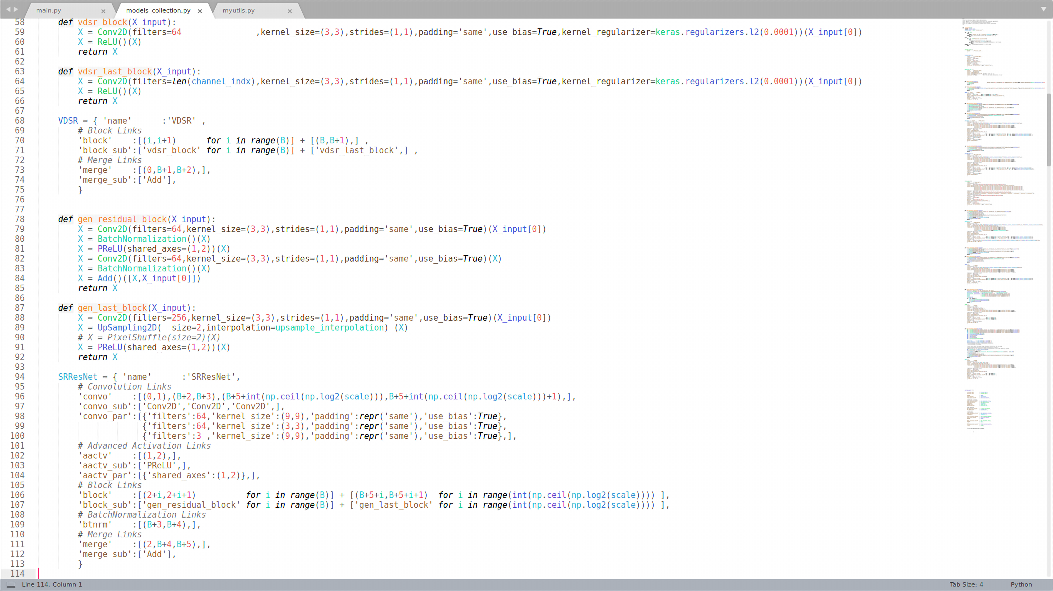
Vision Framework

Slide 26
Patching Approaches
HR Image is first Down-sampled and divided into patches for further processing
HR Image is first divided into patches of desired size and then Down-sampled for further processing
First approach is used
Notes:
Bohot sare coner cases, because bicubic sees aaju baju

